Slide 1

Abbeville Health Center Time Series Analysis
Fargo Health Group
By tyler j. Peters
Notes:
Good afternoon everyone, my name is Tyler Peters. I served as the team lead on this engaging and challenging data science project for Fargo Health Group.
Thank you very much for providing us the opportunity to share these insights with you today.

Slide 2
Business Problem
Fargo Health Group is faced with a critical staffing problem.
Faces increasing demand for appointments with limited resources.
Should Fargo Health Group expand their staff in order to improve physician scheduling?

Slide 3
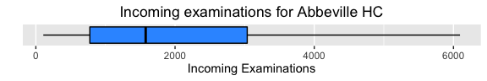
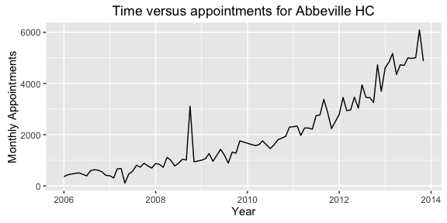
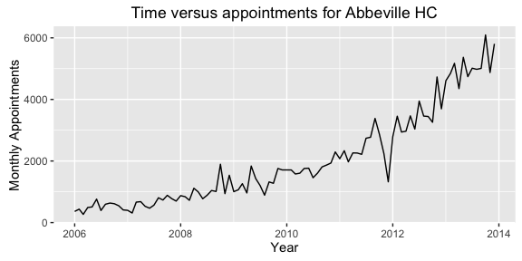
Data Cleaning
Condition of the original dataset
Outliers
Missing data
Erroneous data
Sorting
Data imputation
Reasonably clean dataset

Slide 4
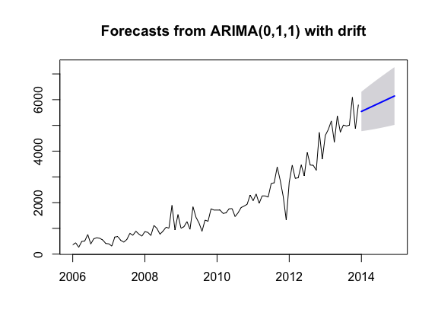
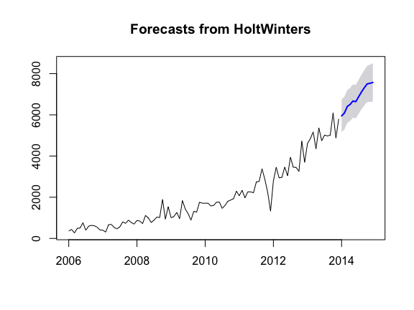
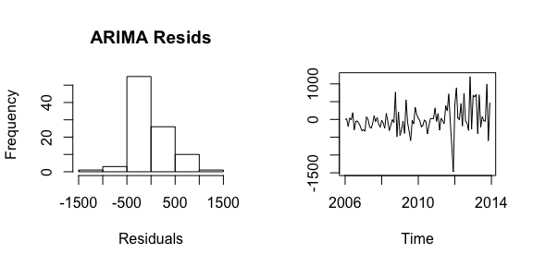
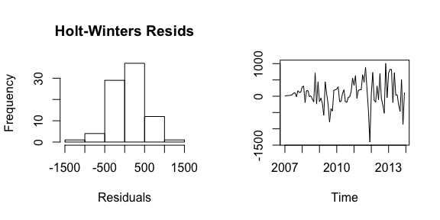
Forecasting Models
Holt-Winters exponential smoothing
Autoregressive integrated moving average (ARIMA)
Notes:
ARIMA – more responsive to historical data
Holt-Winters – does a good job of predicting the trend in the data

Slide 5
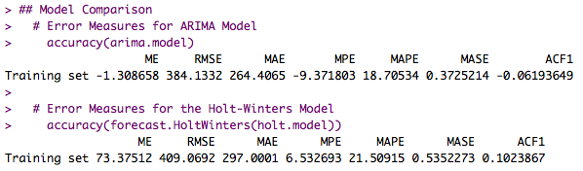
Comparison of Forecasting Models
By comparing the absolute error for each of the model accuracy measures, we find the model that fits the data with the least amount of error.

Slide 6
Recommendations
Based on the trend presented by the ARIMA model – the forecasting model selected – we strongly recommend that additional physicians are hired to meet the predicted, increasing demand for cardiovascular appointments.
Data collection, curation, and storage techniques.
We will be following-up with you at the end of the next few months.

Slide 7
Lessons Learned
Incredible learning opportunity.
Anxious to learn more about each of the areas touched on; predictive analytics and data mining especially!
Ethical implications of this case study.

Slide 8
References
Davenport, T., & Kim, J. (2013). Keeping Up with the Quants: Harvard Business Review Press.
Foreman, J. W. (2014). Data Smart. Indiana: Wiley.
Khachatryan, D. (2014). Fargo Health Group: Managing the Demand for Medical Examinations Using Predictive Analytics. In B. College (Ed.): Harvard Business Publishing.
Zumel, N., & Mount, J. (2014). Practical Data Science with R (1 ed.): Manning.

